Slide 1
Building Arduino Applications
Dr. Abdelhameed Ibrahim Assoc. Prof. Computer Engineering

Slide 2
Part 1
Welcome to the course!
During Day 1,
Introduction to the training course.
Know about Arduino
Learn how to assemble a circuit on a breadboard.
Development tools for Arduino IDE
First coded program
Macro definitions, variables, counting loops

Slide 3
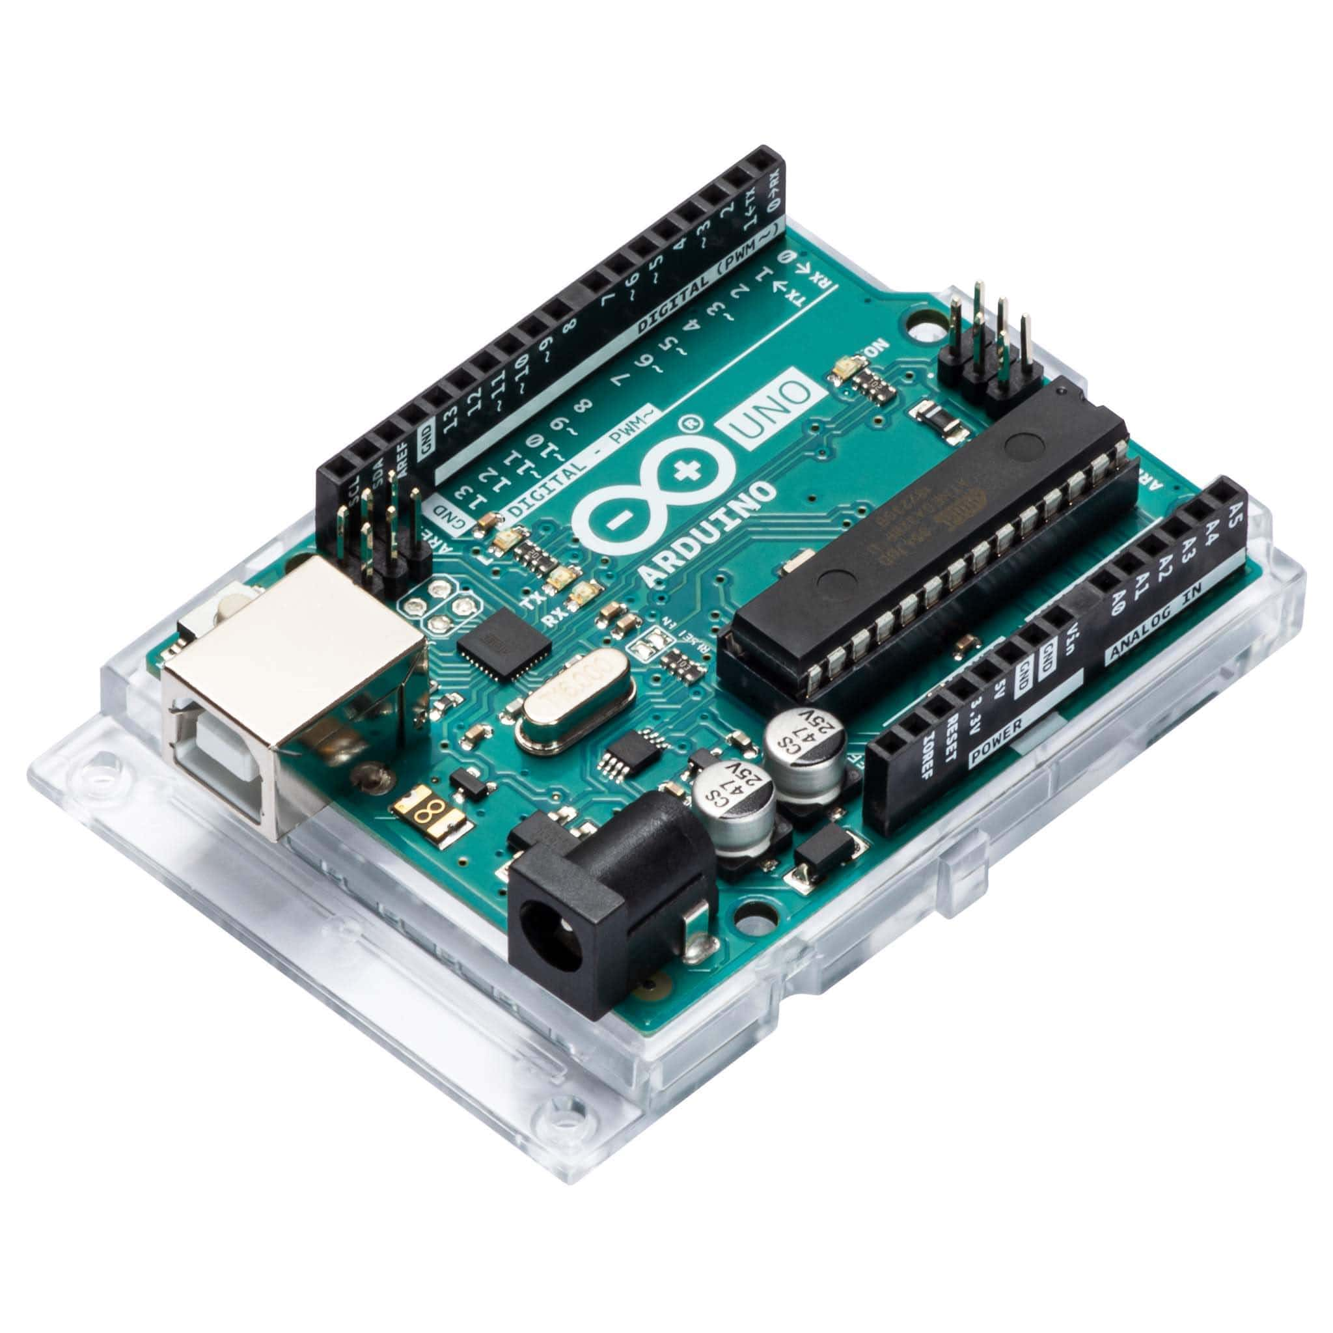

Arduino Uno

Slide 4
Arduino Uno
Microcontroller | ATmega328P
Operating Voltage | 5V
Input Voltage (recommended) | 7-12V
Input Voltage (limit) | 6-20V
Digital I/O Pins | 14 (of which 6 provide PWM output)
PWM Digital I/O Pins | 6
Analog Input Pins | 6
DC Current per I/O Pin | 20 mA
DC Current for 3.3V Pin | 50 mA
Flash Memory | 32 KB (ATmega328P) of which 0.5 KB used by bootloader
Clock Speed | 16 MHz
LED_BUILTIN | 13
Length | 68.6 mm
Width | 53.4 mm
Weight | 25 g

Slide 5
Arduino Board Breakdown
Reset Button –restart any code that is loaded to the Arduino board.
AREF – Stands for “Analog Reference” and is used to set an external reference voltage
Digital Input/Output – Pins 0-13 can be used for digital input or output
PWM – The pins marked with the (~) symbol can simulate analog output
USB Connection – Used for powering up your Arduino and uploading sketches
TX/RX – Transmit and receive data indication LEDs
ATmega Microcontroller – The brain and is where the programs are stored
Power LED Indicator –lights up anytime the board is plugged in a power source

Slide 6
Arduino Board Breakdown
9. Voltage Regulator –controls amount of voltage going into Arduino board
10. DC Power Barrel Jack –used for powering the Arduino with a power supply
11. 3.3V Pin – This pin supplies 3.3 volts of power to your projects
12. 5V Pin – This pin supplies 5 volts of power to your projects
13. Ground Pins – There are a few ground pins on the Arduino
14. Analog Pins – These pins can read the signal from an analog sensor and convert it to digital

Slide 7
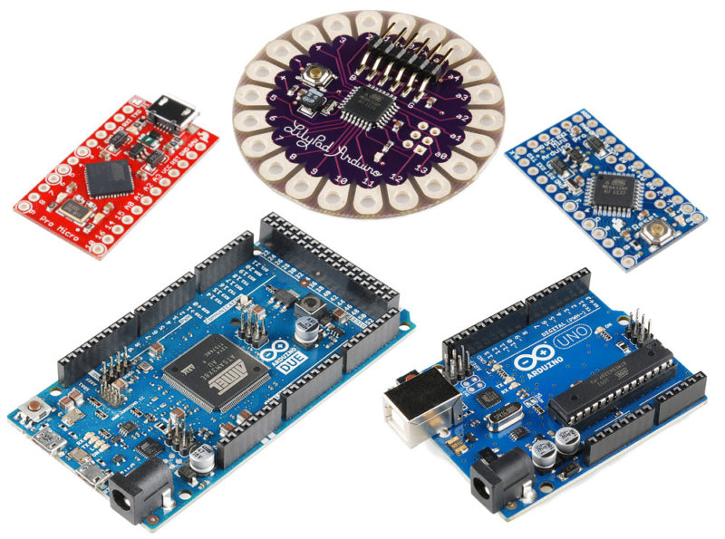
Types of Arduino Boards

Slide 8
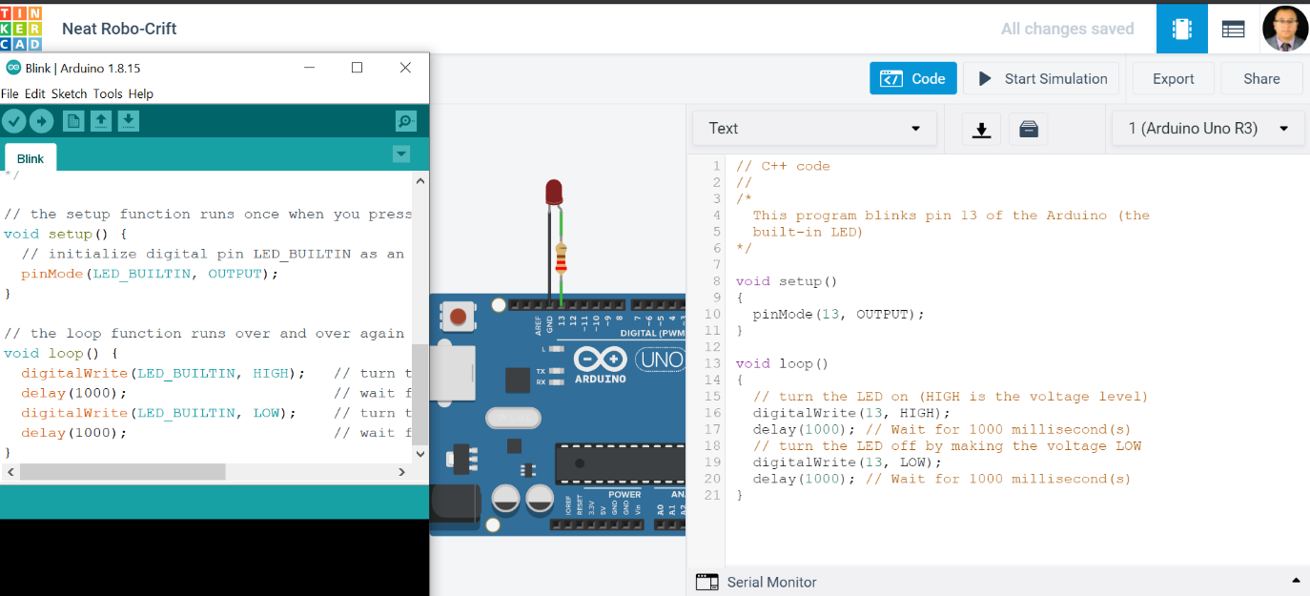
How To Program Arduino
https://www.arduino.cc/
https://www.tinkercad.com/dashboard

Slide 9
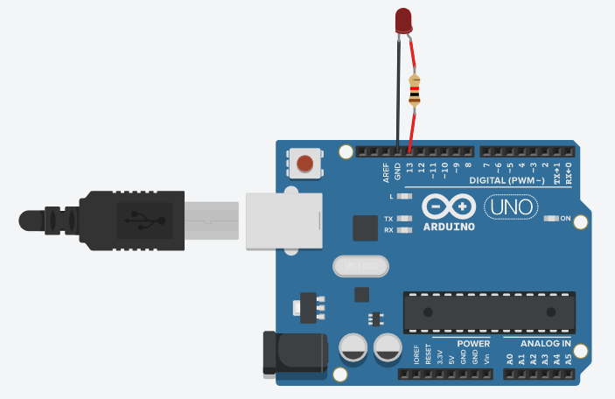
List of experiments
TUTORIALS > Built-In Examples > 01.Basics > Blink

Slide 10
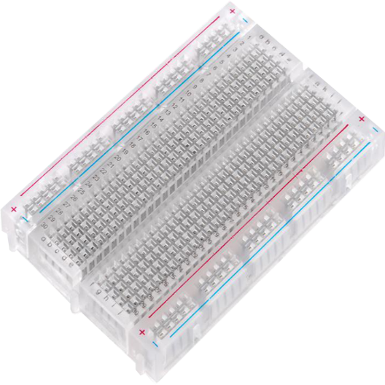
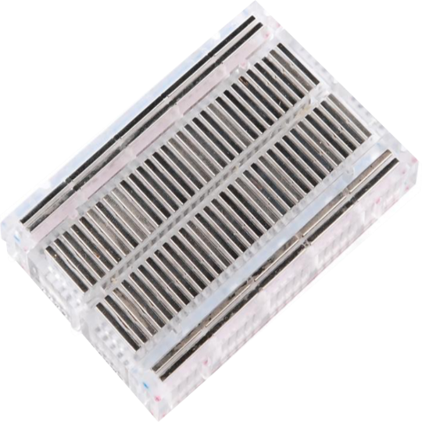
What’s a Breadboard?

Slide 11
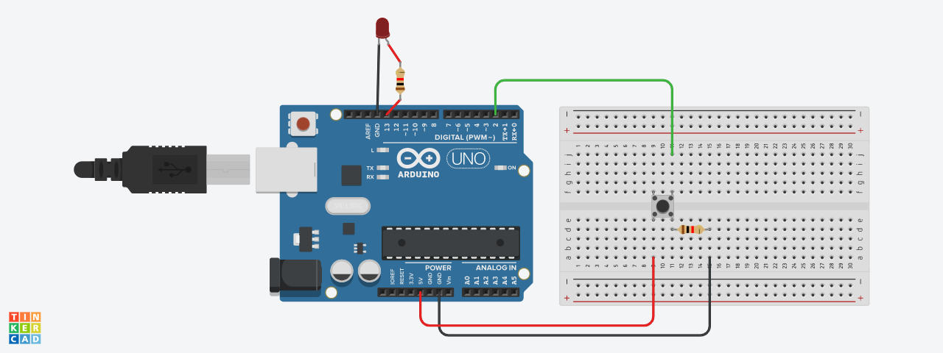
TUTORIALS > Built-In Examples > 02.Digital > Button

Slide 12
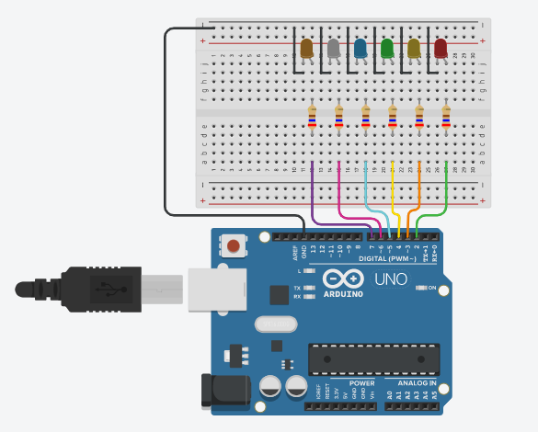
TUTORIALS > Built-In Examples > 05.Control > ForLoopIteration

Slide 13
Part 2
Learn how to receive data with the help of sensors.
First sensor
Reading off analog and digital signals
Joystick app and testing
Seven-segment display
Tone Melody
RGB sensor

Slide 14
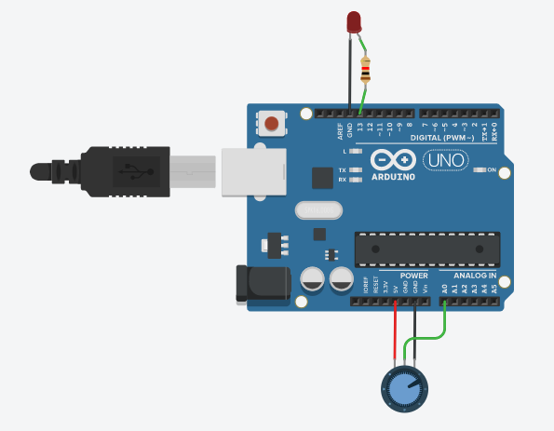
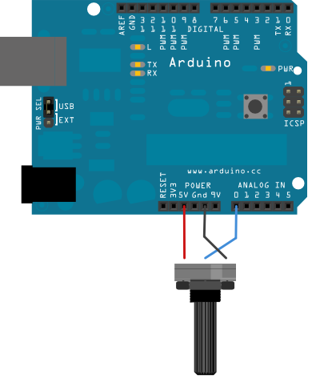
List of experiments
TUTORIALS > Built-In Examples > 03.Analog > AnalogInput

Slide 15
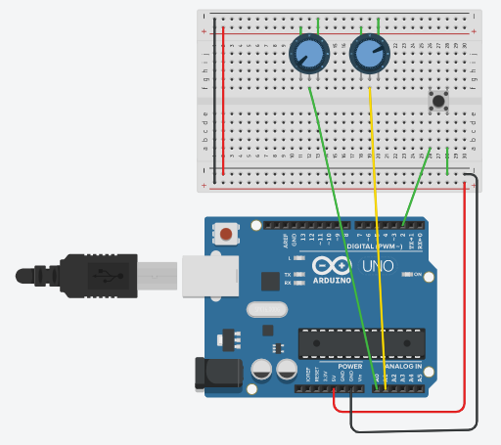
Joystick Control
Code: Lesson 12 Analog Joystick Module
https://github.com/afai79/Arduino/blob/main/Books/Elegoo.zip

Slide 16
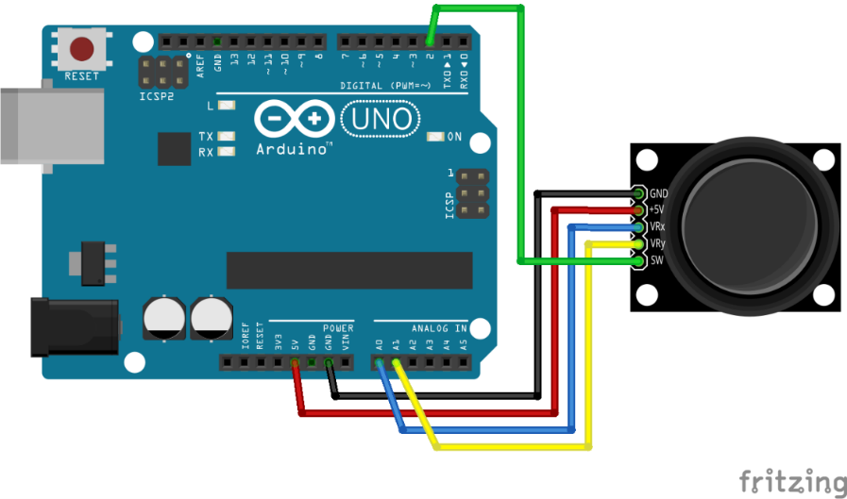
Joystick Control
Code: Lesson 12 Analog Joystick Module
https://github.com/afai79/Arduino/blob/main/Books/Elegoo.zip

Slide 17
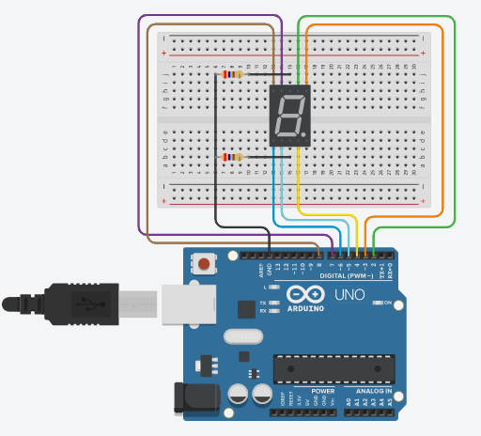
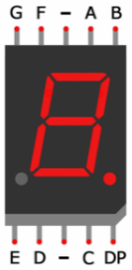
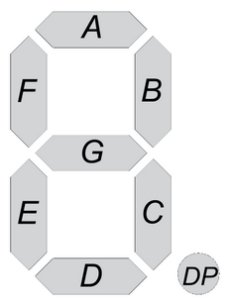
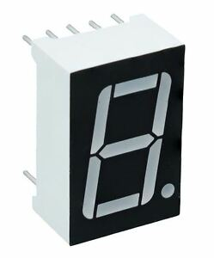
7 Segment
https://github.com/afai79/Arduino/blob/main/7_segment.ino

Slide 18
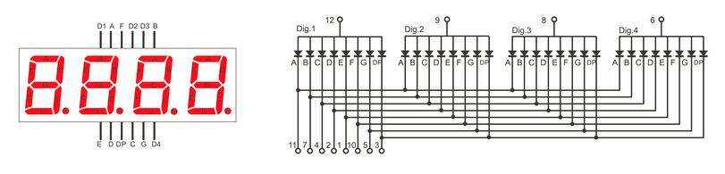
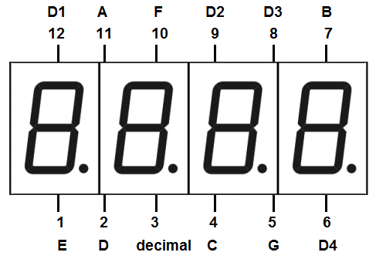
Four Digital Seven Segment Display

Slide 19
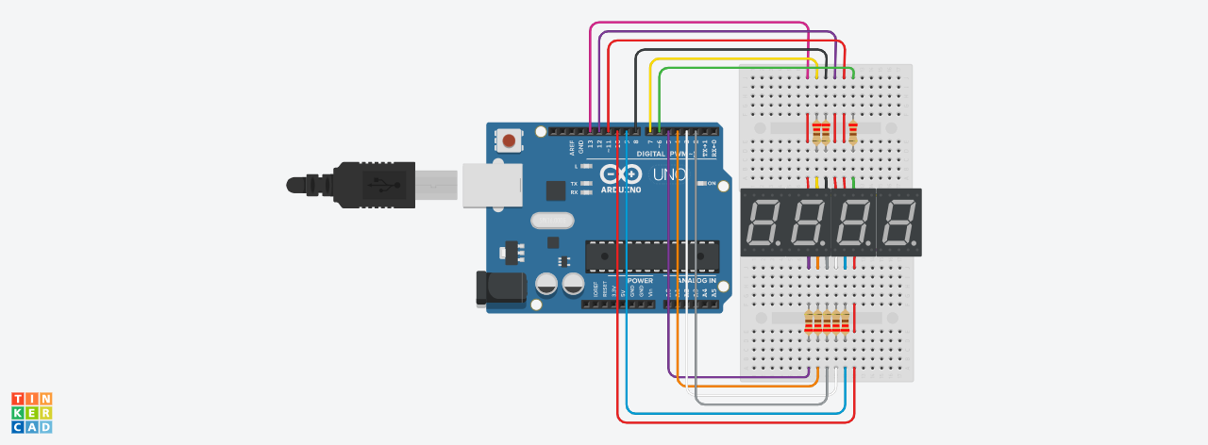
https://github.com/afai79/Arduino/blob/main/4_digit_7_segment.ino

Slide 20
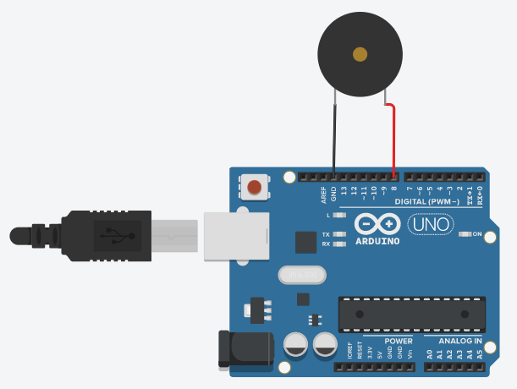
Tone Melody
https://www.arduino.cc/en/Tutorial/BuiltInExamples/toneMelody
https://github.com/afai79/Arduino/blob/main/Lib/pitches.zip

Slide 21
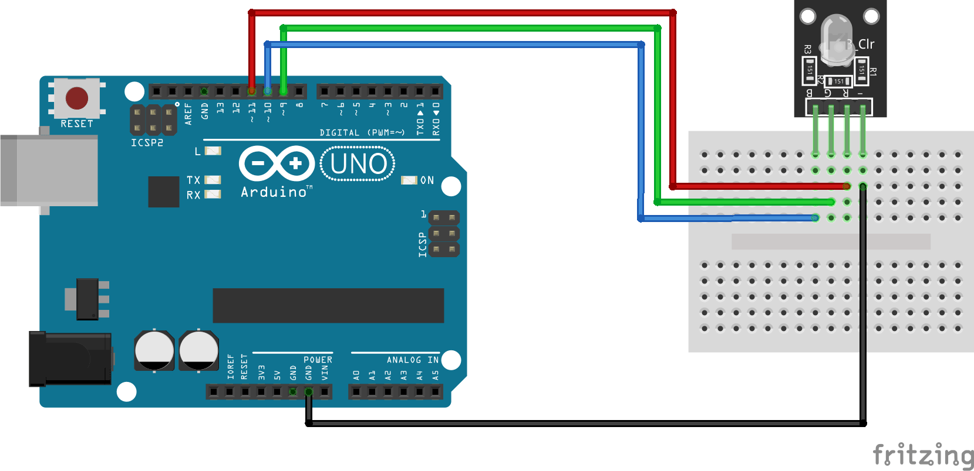
RGB sensor
Code: Lesson 4 RGB LED
https://github.com/afai79/Arduino/blob/main/Books/Elegoo.zip

Slide 22
Part 3
Learn to create a step motor and create devices which can perform very precise actions.
Servo motor and libraries
Ultrasonic Sensor
PIR Sensor
LCD
LCD with I2C
Temperature sensor
Water level Sensor
Step motor

Slide 23
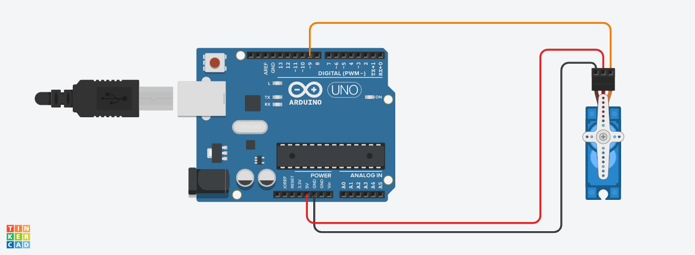
Servo motor control
Code: Lesson 9 Servo
https://github.com/afai79/Arduino/blob/main/Books/Elegoo.zip

Slide 24
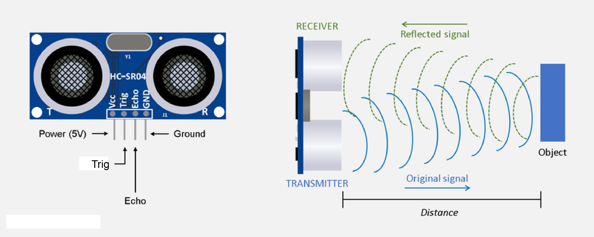
Ultrasonic Sensor

Slide 25
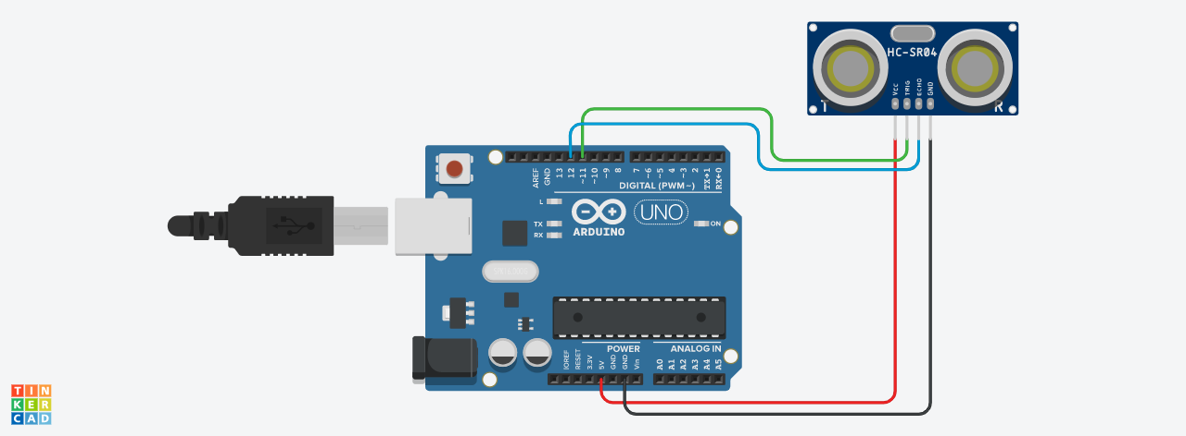
Ultrasonic Sensor
https://github.com/afai79/Arduino/blob/main/Ultrasonic.ino

Slide 26
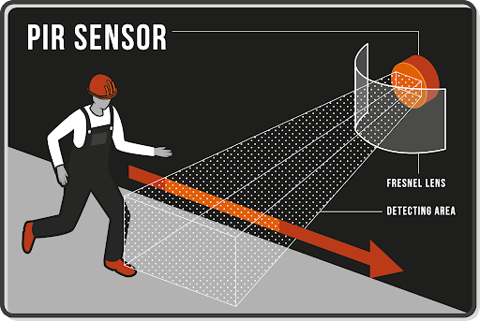
PIR Sensor
https://github.com/afai79/Arduino/blob/main/PIR_Sensor.ino

Slide 27
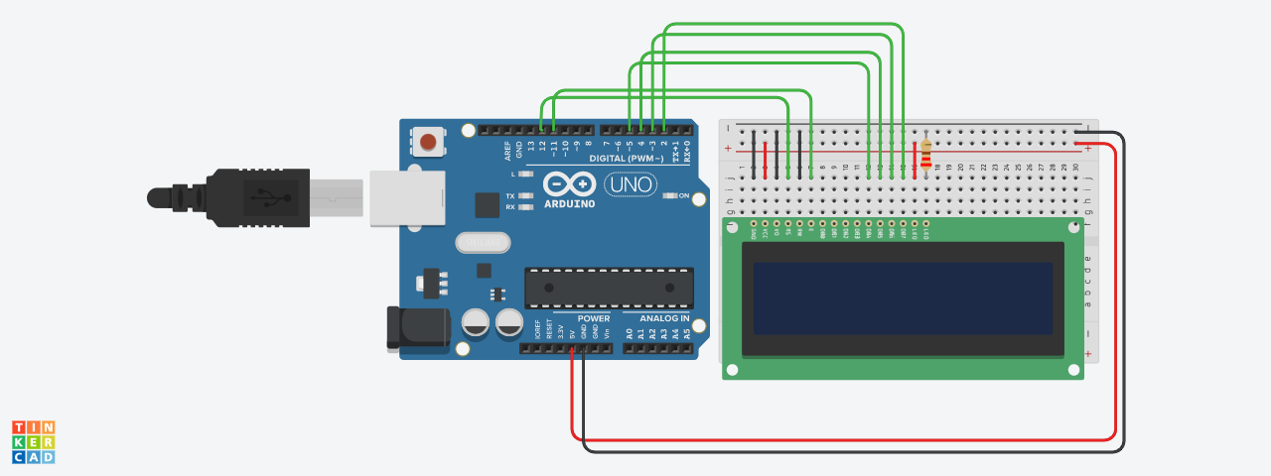
LCD
https://github.com/afai79/Arduino/blob/main/LCD.ino

Slide 28
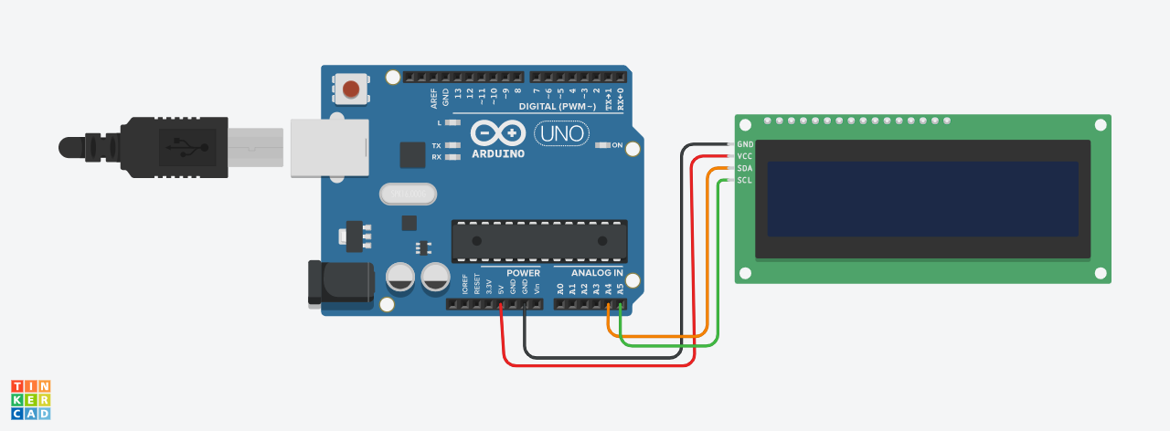
LCD with I2C
https://github.com/afai79/Arduino/blob/main/LCD_I2C.ino

Slide 29
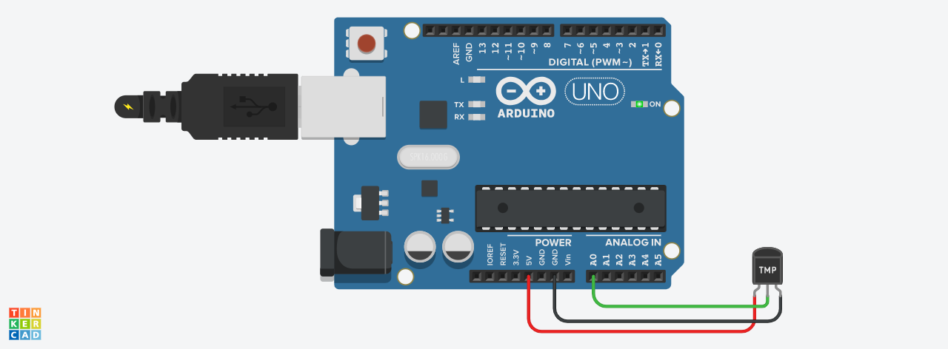
Temperature sensor.
https://github.com/afai79/Arduino/blob/main/Temperature.ino

Slide 30
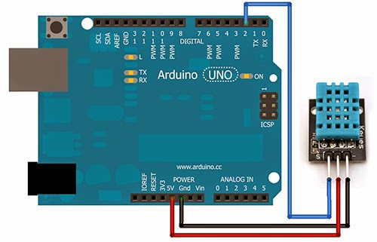
List of experiments
Temperature and humidity sensor.
Code: Lesson 11 DHT11 Temperature and Humidity Sensor
https://github.com/afai79/Arduino/blob/main/Books/Elegoo.zip

Slide 31
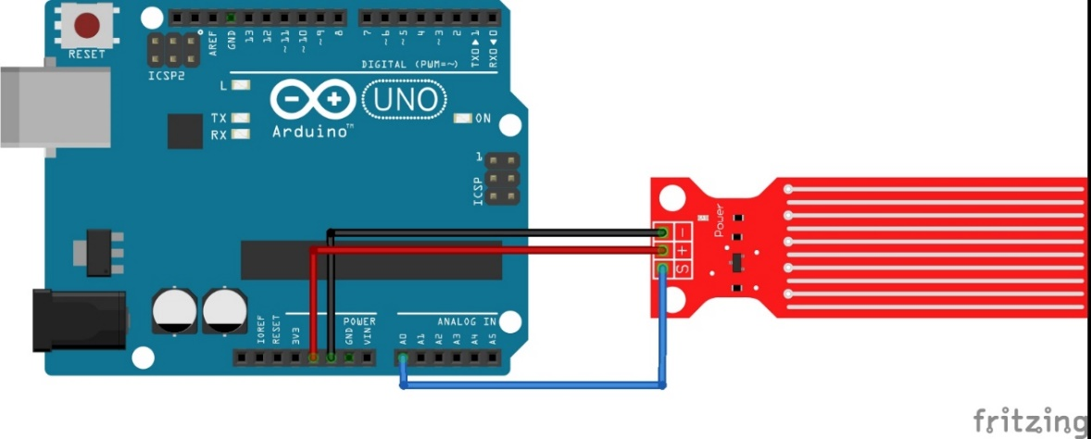
Water level Sensor
https://www.thegeekpub.com/236571/arduino-water-level-sensor-tutorial/
https://github.com/afai79/Arduino/blob/main/water_level.ino

Slide 32
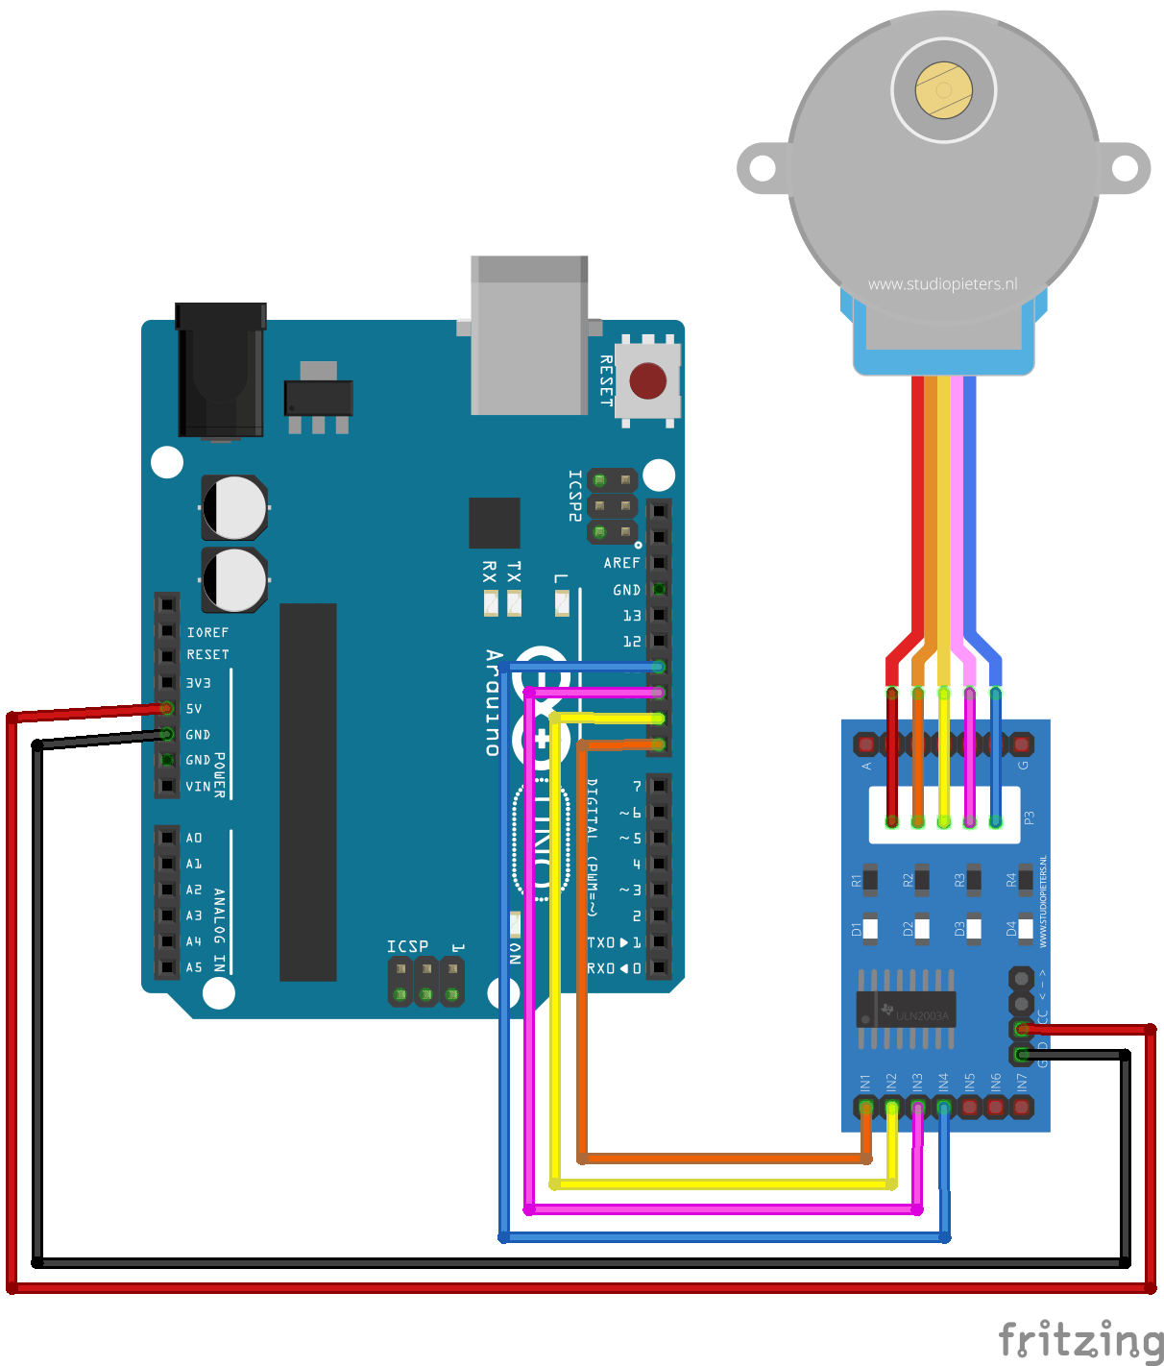
Stepper motor
Code: Lesson 23 Stepper Motor
https://github.com/afai79/Arduino/blob/main/Books/Elegoo.zip

Slide 33
Part 4
Having learnt to use a lot of sensors and devices with Arduino
During Part 4, you are ready to make various small projects based on your skills.
Small Project 1: Air Quality Detector
Small Project 2: Control servo motor by RGB sensor
Small Project 3: Smart House

Slide 34
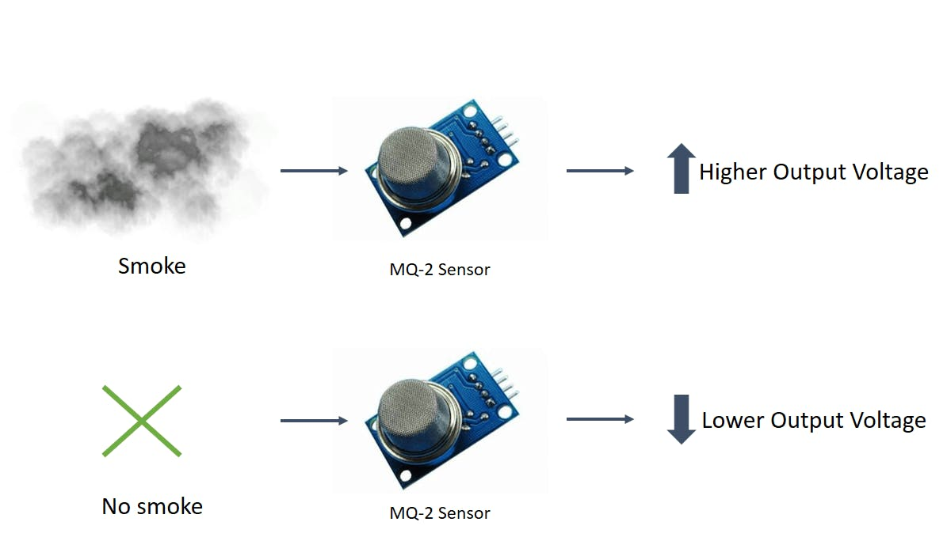
Small Project 1: Air Quality Detector
Gas Sensor

Slide 35
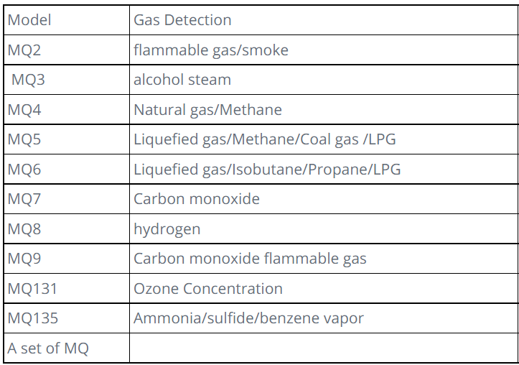

Slide 36
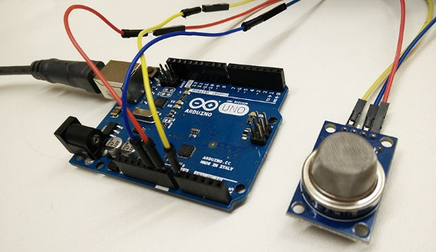
https://github.com/afai79/Arduino/blob/main/Gas_sensor.ino
https://github.com/afai79/Arduino/blob/main/Gas_sensor-LED-Motor.ino

Slide 37
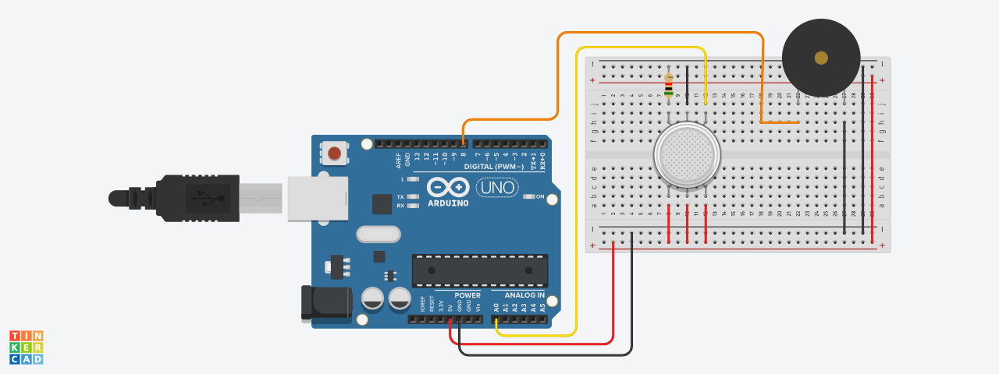
https://github.com/afai79/Arduino/blob/main/Gas_Piezo.ino

Slide 38
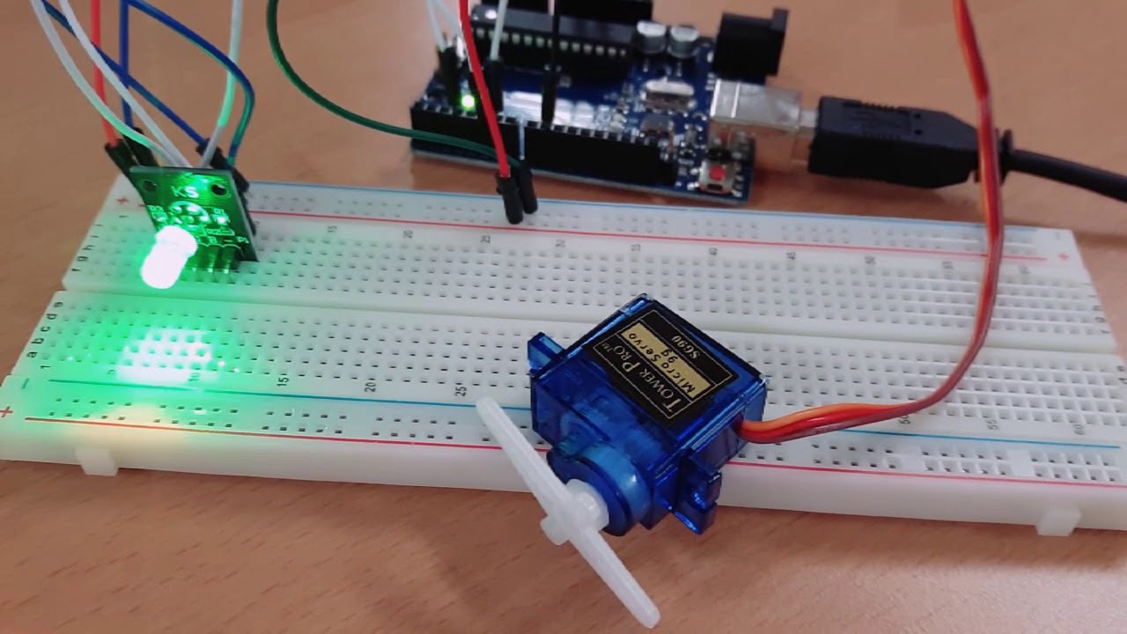
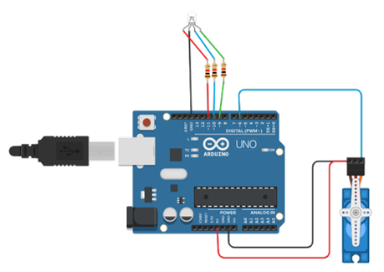
Small Project 2: Control servo motor by RGB sensor
https://github.com/afai79/Arduino/blob/main/RGB_LED-motor.ino

Slide 39
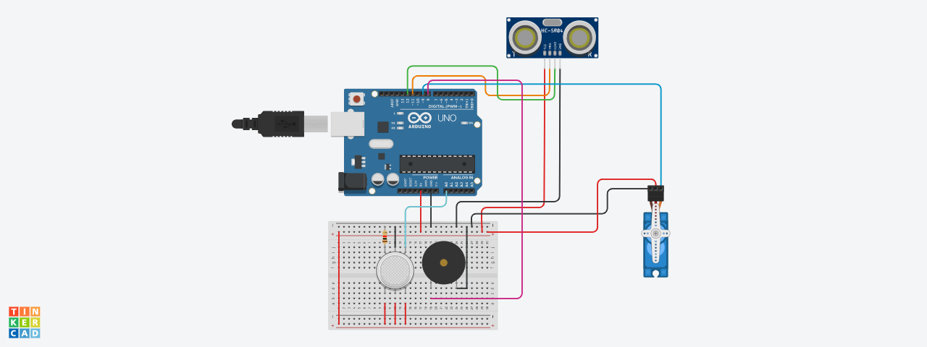
Small Project 3: Smart House
https://github.com/afai79/Arduino/blob/main/Ultrasonic_Servo_Gas_P.ino

Slide 40
Part 5
Arduino Robot
We are going to build an Arduino based robot capable of avoiding obstacles in its path.
It is a great learning experience, let us get started!
https://educ8s.tv/arduino-robot-easy-diy-project/
https://github.com/afai79/Arduino/tree/main/ArduinoRobot

Slide 41
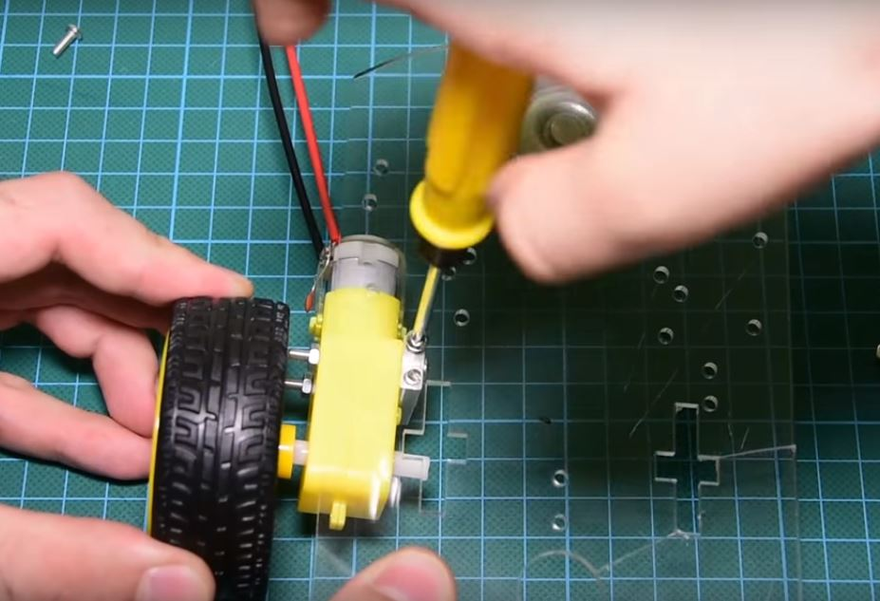
Building the Robot
Step 1. Connect the motor and wheels to the chassis.

Slide 42
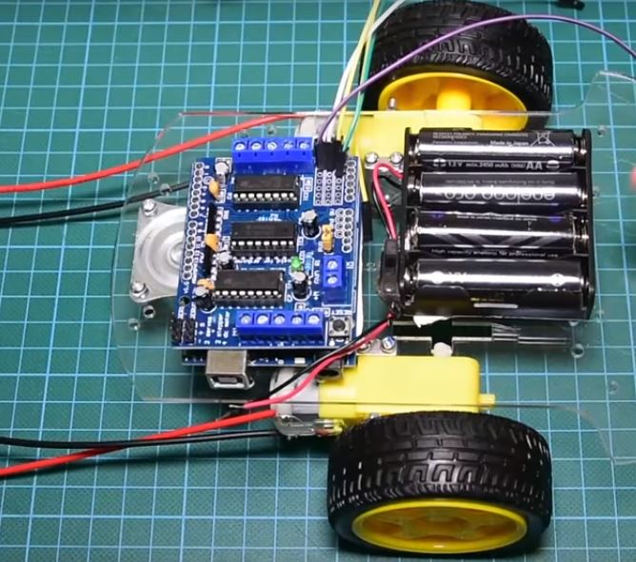
Step 2: Prepare the Switch and connect the Power Source
Step 3: Mount other Parts on the chassis.

Slide 43
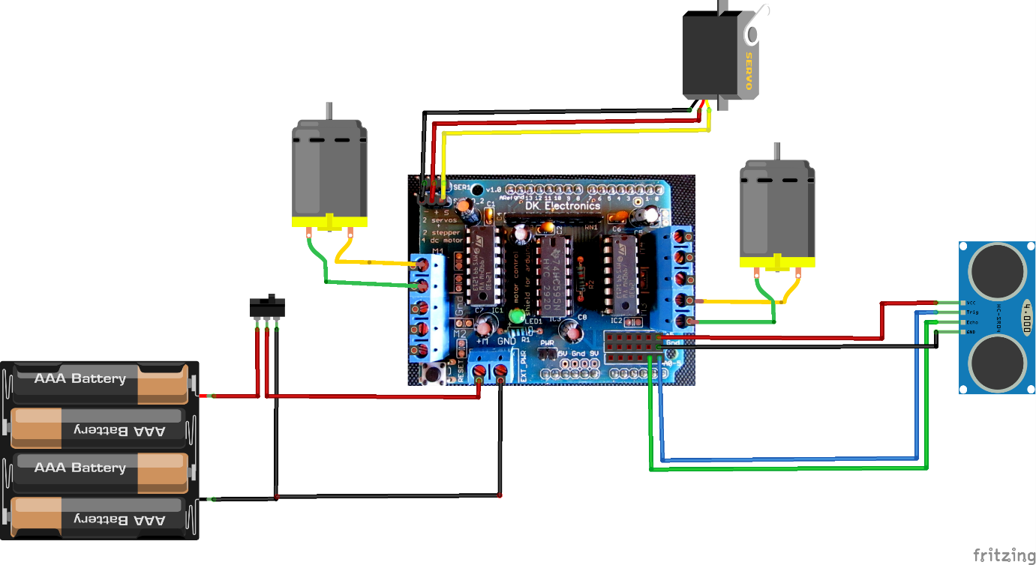
Schematics
Wire up the components together as shown in the image below.

Slide 44
Code
The code uses three libraries.
Two of them must be downloaded for the program to compile.
The first one is the motor shield driver from Adafruit.
The second library is the NewPing library for the supersonic distance sensor.
https://github.com/afai79/Arduino/blob/main/ArduinoRobot/ArduinoRobot_.ino

Slide 45
LIBRARIES
Motor Shield Library:
https://github.com/afai79/Arduino/blob/main/ArduinoRobot/Adafruit-Motor-Shield-library-master.zip
New Ping Library:
https://github.com/afai79/Arduino/blob/main/ArduinoRobot/NewPing_v1.9.1.zip

Slide 46
End of Training!

